Slide 1
Kanen Online
Shopping
Alexis Cuntapay
Christian Joel Kanen
Jerica Flores
John Benedict Vergara
Melvin Robert Yu
Sebastian Briones

Slide 2
Kanen Online Shopping
We sell gadgets such as laptops and phones
Users can:
Admin can:
Register on the shopping site
Login with their username and password
Update their own information
View the products
Search products
Add products to cart
Give comments to a product
Can add products to their wish list
Can become a member with discount
View the history of their orders
Maintain products
Update the users’ membership types
Blacklist users
Check count and view “logged in” users

Slide 3
Distribution of tasks
Alexis:
Kanen:
Blacklisted users Interceptor
UI Designer
Product details
User profile maintenance
User membership requests
Admin membership approval UI
Product maintenance form
Order maintenance form
Product - DAOImpl, Service, and Controller
Melvin:
Jerica:
Majority of Admin side backend
JMS for consuming membership requests
All users maintenance UI
View online users form and backend
Product comments – DAO, Service and Controller
Save user cart on logout / load on login
Membership Type, User and Product Controller
JB:
Save cart/ order Controller, Service and DAO
Customer wishlist – form, controller and DAO
Membership Type controller
All Entities
Sebastian:
Product display
Add to cart
Product search
Class diagram
Assign tasks
Login and register forms

Slide 4
Common tasks:
JUnit Test case for own functions
ExtJS Window
Update DB and ERD
Controller, DAOImpl

Slide 5
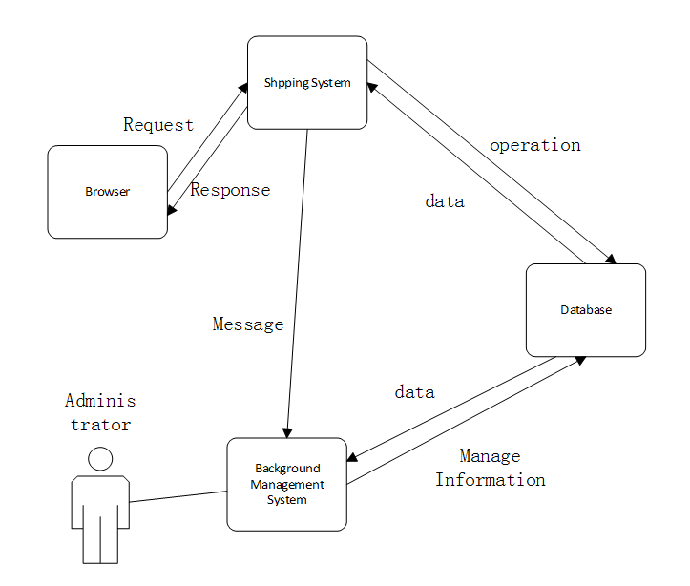
Architecture:

Slide 6
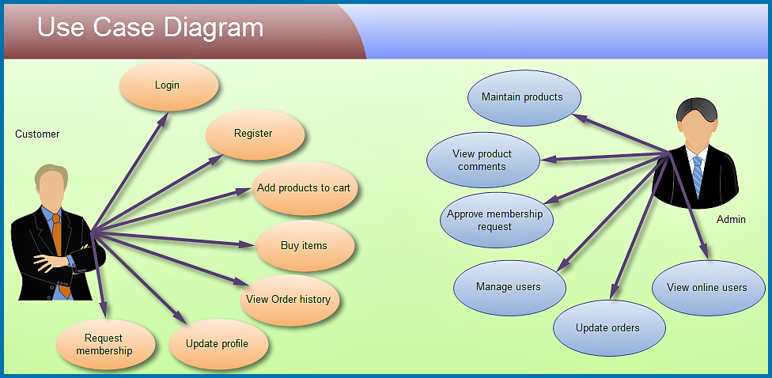

Slide 7
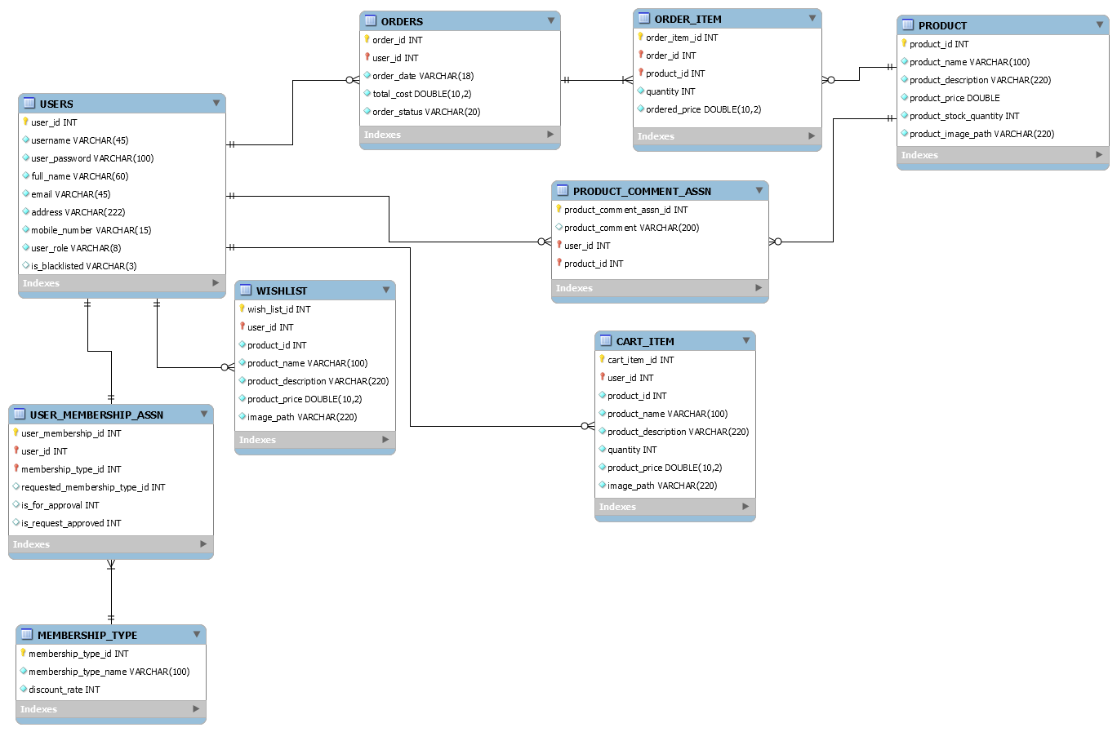
Entity Relationship Diagram

Slide 8
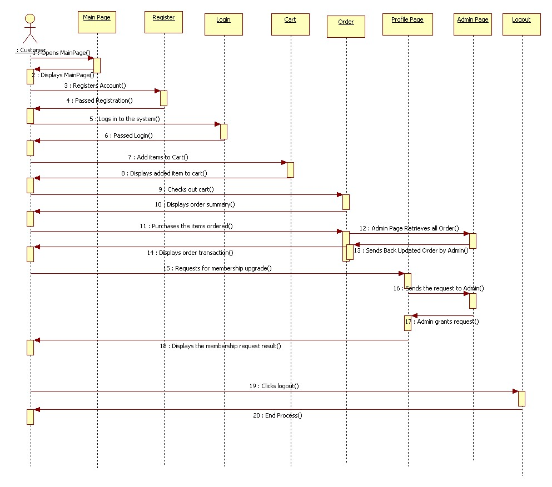
Sequence Diagram

Slide 9
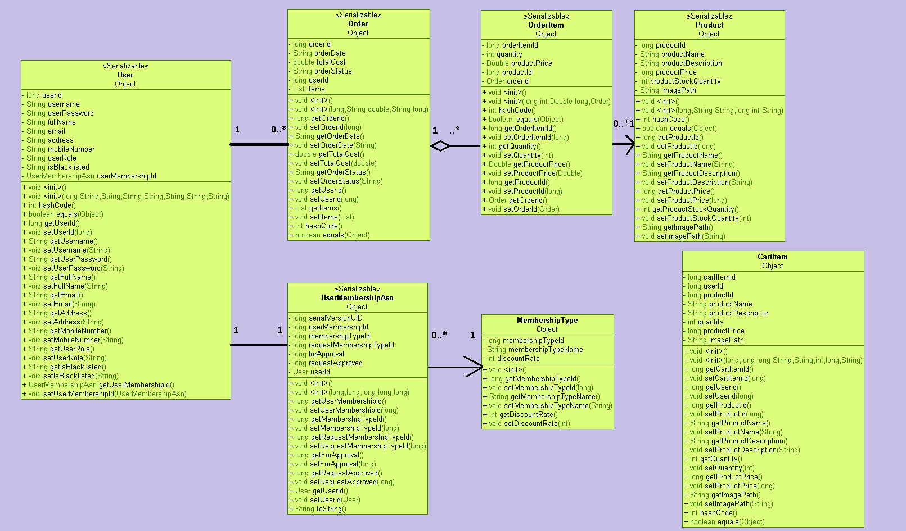
Class Diagram - Entities

Slide 10
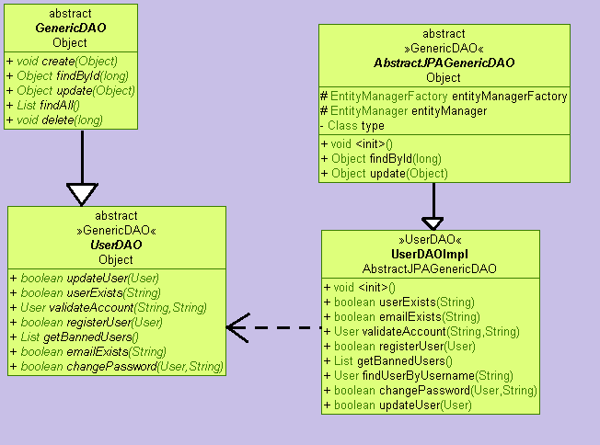
Class Diagram - DAOs

Slide 11
Project Demonstration

Slide 12
Learnings applied:
ExtJS 4 and Spring Framework
Ajax and JSON
Java Persistence API
Salted password hashing
Spring Interceptor/ Filter
Transaction
Log4J
JMS Producer and Consumer
JUnit
Webservice

Slide 13
Q & A

